Slide 1


Military Institute Of Science & Technology
Artificial Intelligence
CSE-404
Final Project Presentation

Slide 2
Group Members
Group 02
Jamal Uddin Tanvin - 202014016
2. Jubair Ahmed - 202014018
3. Muhammad Rifat Islam - 202014034
4. MD Tausiful Haque - 202014036
5. Nurshat Fateh Ali - 202014040

Slide 3

Project Title
YouTube Video Summarization
Using Google T5 & SpaCy

Slide 4
Analyze youtube video using its link and then give a summary of that video in a textual form
Features
What we want to achieve

Slide 5
Dataset Collection
CNN/Dailymail
CNN_Dailymail
Over 300k unique articles
Article (string)
Highlights (string)
Web Scrapping
The CNN / DailyMail is an English-language dataset containing just over 300k unique articles on science, geopolitics, tech and so on. The current version supports both extractive and abstractive summarization, though the original version was created for machine reading, comprehension and abstractive question answering. [1]

Slide 6

Models & Libraries
Text-To-Text Transfer Transformer Model for abstractive summarization.
Google T5 is an encoder-decoder model pre-trained on a multi-task mixture of unsupervised and supervised tasks and for which each task is converted into a text-to-text format.
Google T5 works well on a variety of tasks out-of-the-box by prepending a different prefix to the input corresponding to each task [2]

Slide 7
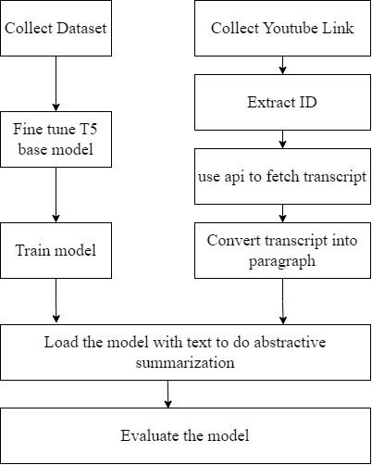
Procedure T5

Slide 8

Models & Libraries
SpaCy library Model is used for extractive summarization
SpaCy is an open-source and free library for Natural Language Processing (NLP) in Python having a lot of in-built functionalities
It is popular because of its speed, ease of use and its accuracy [3]

Slide 9
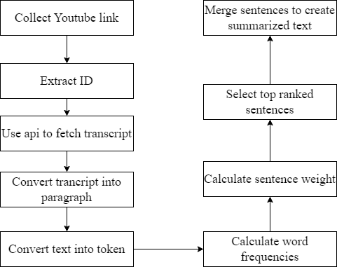
Procedure SpaCy

Slide 10


Demonstration
Google T5
SpaCy

Slide 11
Evaluation
ROUGE stands for Recall-Oriented Understudy for Gisting Evaluation.
It is essentially of a set of metrics for evaluating automatic summarization of texts as well as machine translation.
It works by comparing an automatically produced summary or translation against a set of reference summaries (typically human-produced). [4]
Rouge metrics measure the word overlap between generated text and expected text.
Since good summaries & headings can be written differently, Rouge scores around 50 are considered excellent results.

Slide 12


Future Works
Accuracy can be increased | An extension of browser can also be developed

Slide 13
References
[1]https://huggingface.co/datasets/cnn_dailymail
[2]https://huggingface.co/docs/transformers/model_doc/t5
[3]https://www.analyticsvidhya.com/blog/2021/06/beginners-guide-of-natural-language-processing-using-spacy/
[4]https://kavita-ganesan.com/what-is-rouge-and-how-it-works-for-evaluation-of-summaries/

Slide 14



THANK YOU
"Today, AI is in the hands of the high priests and priestesses. But most people have access only to the AI that they build for them. In the coming era for AI, we'll empower everyone to build AI systems for themselves."

